Slide 1


Minor Project
Title: Emotion Detection From Acoustic Sounds ​
(Generalised for Human, Animal & Birds)​
Presented by:​
Roll number - Abhinav Singh Kushwaha ​
Roll number - Aelish Kumar ​
Roll number - Saloni Sukirti​
​
Mentored By:
Dr. Ajay Prasad

Slide 2
Content
Introduction
Literature Review
Objectives
Methodology
Working Model
References

Slide 3
Introduction
The project aims to advance the field of emotion detection from acoustic sound, with real-time applications in, communication, and animal behavior.
Emotions can be expressed through various mediums, including acoustic sounds, and detecting emotions from acoustic sound has gained significant attention in recent years.
Acoustic sound has unique characteristics and patterns that can distinguish emotions, such as variations in pitch, intensity, and rhythm.
Developing a system that can accurately detect emotions from acoustic sound in both humans and animals can deepen our understanding of emotions and their impact on daily life.

Slide 4
Technical Concepts (Algorithms) used:
Feature extraction: The project involves extracting several features from the acoustic sound, including Mel-frequency cepstral coefficients (MFCC), chroma, and Mel features.
Multi-Layer Perceptron (MLP): The project utilizes a Multi-Layer Perceptron (MLP) classifier, which is a type of neural network that can learn and classify data. The MLP classifier is trained on the feature array of sounds, which consists of the extracted MFCC, chroma, and Mel features.
Classification labels: The sounds are labeled with eight different emotion labels, which the MLP classifier is trained to recognize. The eight emotions are labeled in the provided dataset.
Cross-validation: In addition to training the MLP classifier, the project likely uses cross-validation to evaluate the performance of the classifier and optimize its hyperparameters.

Slide 5
Introduction
Problem Statement:
To develop a system that accurately detects emotions from acoustic sounds produced by humans and animals, given the limitations of AI in understanding and responding to emotions
Area of application:
Speech Recognition and Virtual Assistants: Emotion detection from acoustic sounds can be used to improve speech recognition technology and virtual assistants like Alexa, Siri, and Google Assistant. By detecting emotional cues in speech, this technology can help these systems to better understand the user's intent and respond more appropriately.
Animal Behavior Research: Emotion detection from acoustic sounds can be used to understand the emotional states of animals and birds. This technology can help researchers to study the communication patterns of animals and how they express emotions through sounds.​

Slide 6
Literature Review
Our project focuses on emotion detection from acoustic sounds. There are various research works and discoveries that support this area of study.
[1] This study proposes a method for acoustic feature extraction to recognize emotions in speech. Four basic acoustic features (pitch, energy, formant 1, and zero crossing rate) are estimated and their contours are represented by mean, slope, and difference of slope.
[2] The review suggests that various low-level descriptors (LLDs) and features, including energy, spectral, Mel-frequency cepstral coefficients (MFCC), and Chromatic, are used in speech emotion recognition but using too many features can lead to the "curse of dimensionality," resulting in lower classification accuracy. Optimal feature reduction is necessary, so we will be using zero crossing rate (ZCR) and Mel-frequency cepstral coefficients (MFCC), for emotion detection from acoustic sounds

Slide 7
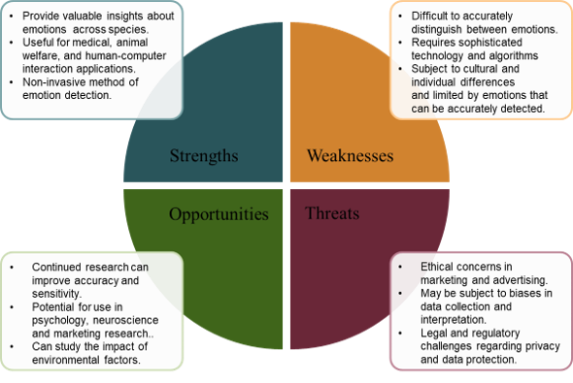
SWOT Analysis :
Fig 1.1 SWOT analysis

Slide 8
Objective
The objective of this project is to develop a system that can accurately detect emotions from acoustic sound in both humans and animals, in a real-world scenario. The system will be capable of detecting emotions in real time and will be able to classify emotions with a high degree of accuracy. Additionally, the system will be flexible enough to adapt to different scenarios and environments, making it useful for many applications.

Slide 9
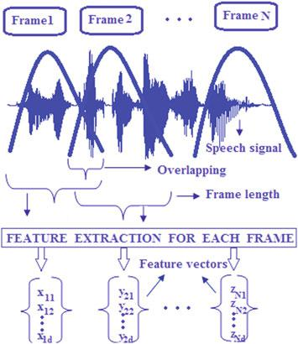
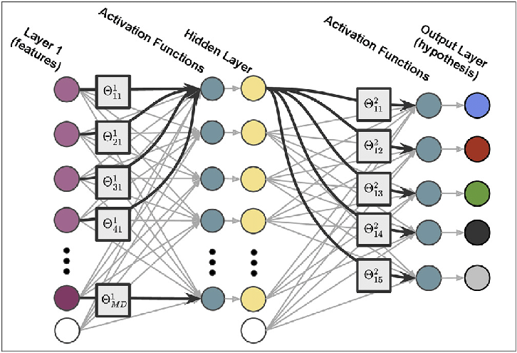
Working Model
Fig. 1.2 The process of splitting the speech signal into several frames and extracting its corresponding feature vector
Fig. 1.3 multilayer perceptron (MLP) model of a multi-classification artificial neural network (ANN)

Slide 10

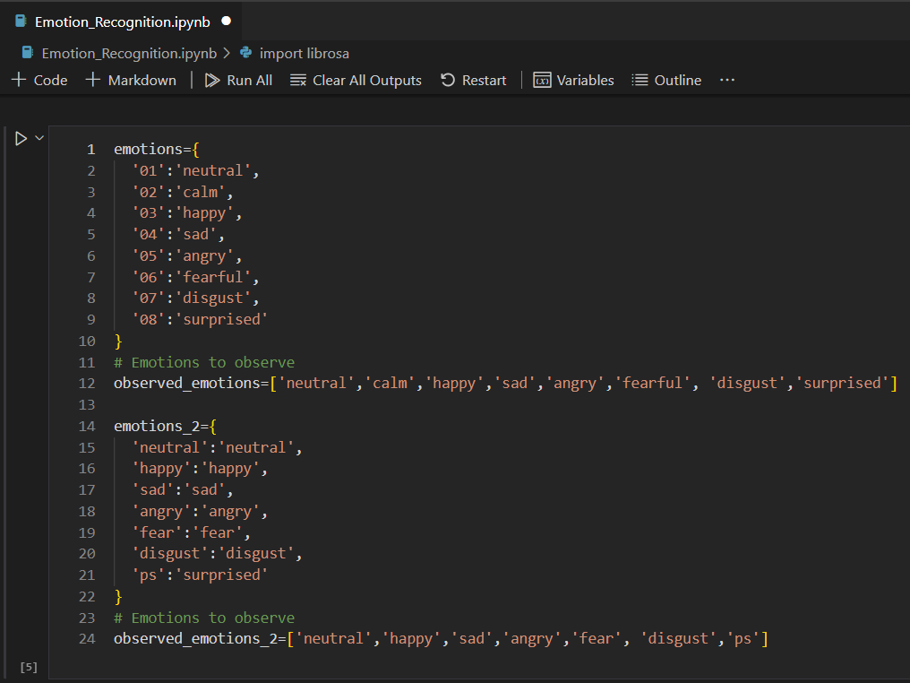
Code Snippets

Slide 11
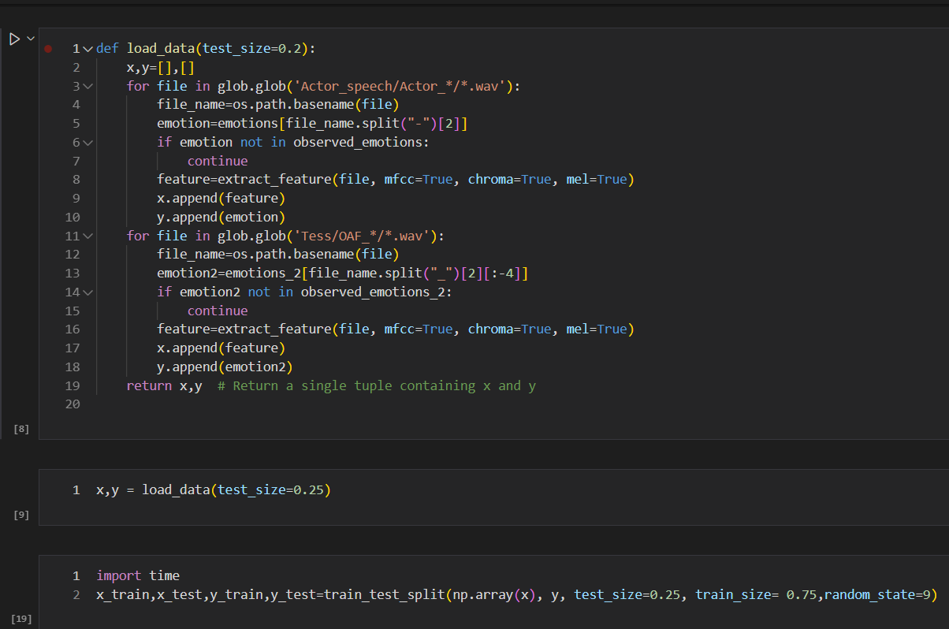

Slide 12
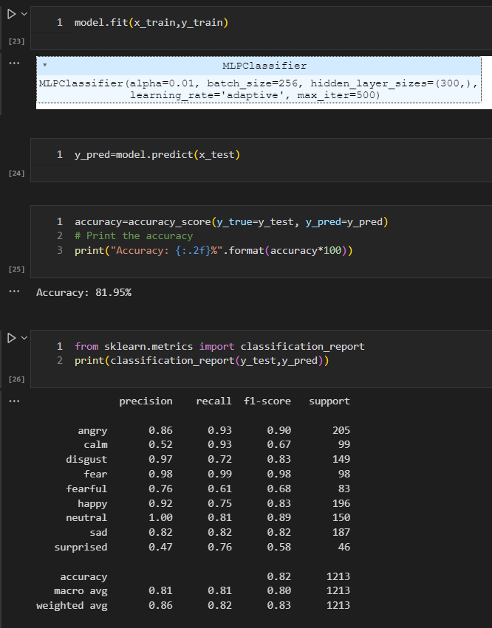
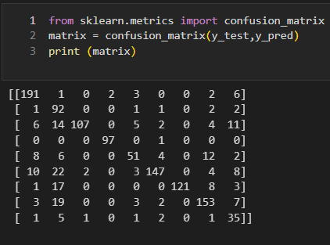
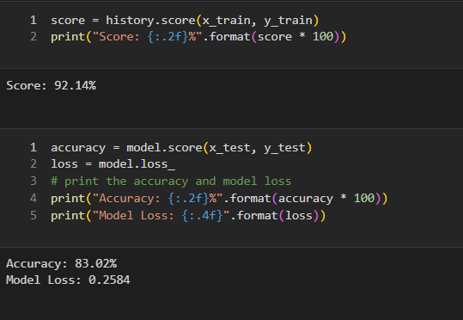

Slide 13
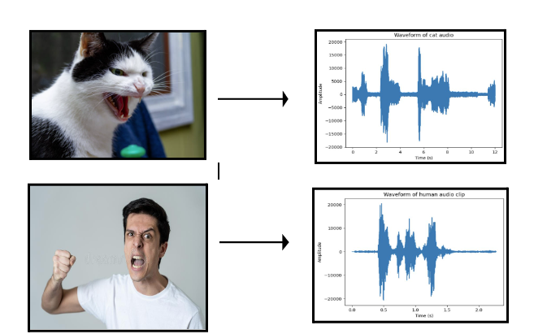
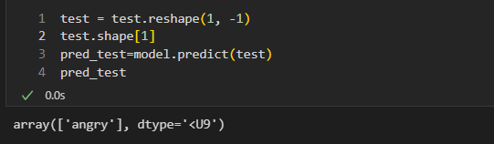
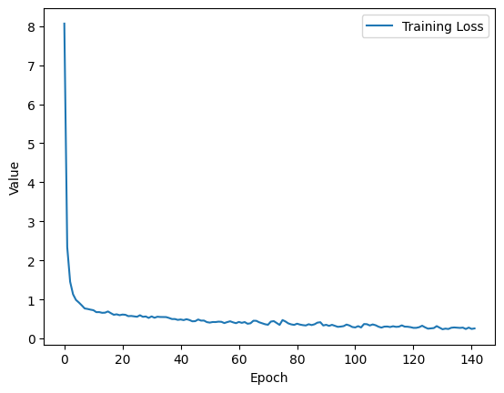
Output:
Fig. 1.4 Emotion Detection of the audio
Fig. 1.5 Model Loss graph

Slide 14
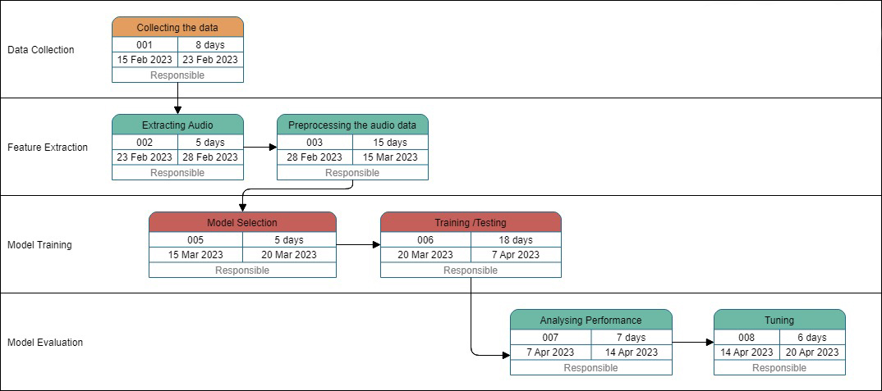
Timeline:

Slide 15
Reference
List of cited papers:
[1] Ze-Jing Chuang and Chung-Hsien Wu (2004) “Emotion recognition using acoustic features and textual content,”. ​
​
[2] Charoendee, M.,Suchato, A. and Punyabukkana, P. (2017) “Speech emotion recognition using derived features from speech segment and kernel principal component analysis,”. ​
​
[3] Hajarolasvadi, N. and Demirel, H. (2020) “Deep emotion recognition based on audio–visual correlation,” IET Computer Vision, 14(7).
[4] Lie Lu, Liu, D. and Hong-Jiang Zhang (2006) “Automatic mood detection and tracking of Music Audio Signals,” IEEE Transactions on Audio, Speech and Language Processing. ​
​

Slide 16
Thank You

